Slide 1

Python for data science (3150713)

Slide 2
Branch: Computer Science Engineering Divison: CSE-2 Name: Parmar Jignasha Enrollment no: 210050131531 Name: Parmar Drashti Enrollment no: 210050131507

Slide 3
COVID-19 DATA ANALYSIS

Slide 4
Abstract:- Corona Virus Disease- 19 (COVID-19) was first time reported in Wuhan, China. This disease has covered more than 200 countries till May 2020. World Health Organisation (WHO) has declared COVID-19 as Public Health Emergency of International Concern (PHEIC) on 30 January 2020. COVID- 19 causes severe acute respiratory syndrome coronavirus 2 (SARS-CoV-2) which was progressive earlier in China but now in maximum countries. Therefore, the different online platform are used which provides the latest update of confirmed corona cases throughout the globe for the analysis of data. The aim of data analysis for CIVID-19 is to aware of the community against the infectious disease and forecast the COVID-19 confirmed cases, deaths, and recoveries through the data analysis methods. Different models are also used to study the behavior of the disease. The models help to forecast the patterns of public sentiments on health information with both the political and economical influence of the spread of the virus. Data analysis methods which are used are Exploratory Data Analysis (EDA) in which the number of confirmed cases, death, and recovered data are recorded, model like Susceptible-Exposed-Infectious-Recovered (SEIR) model is used to predict the time and the rate taken for the spreading up of disease throughout the globe. A statistical model can also be used to compare the data among different countries to make humans aware of the infection.

Slide 5
Data set:- Country wise latest Day wise Full grouped Usa country wise Worldometer data

Slide 6
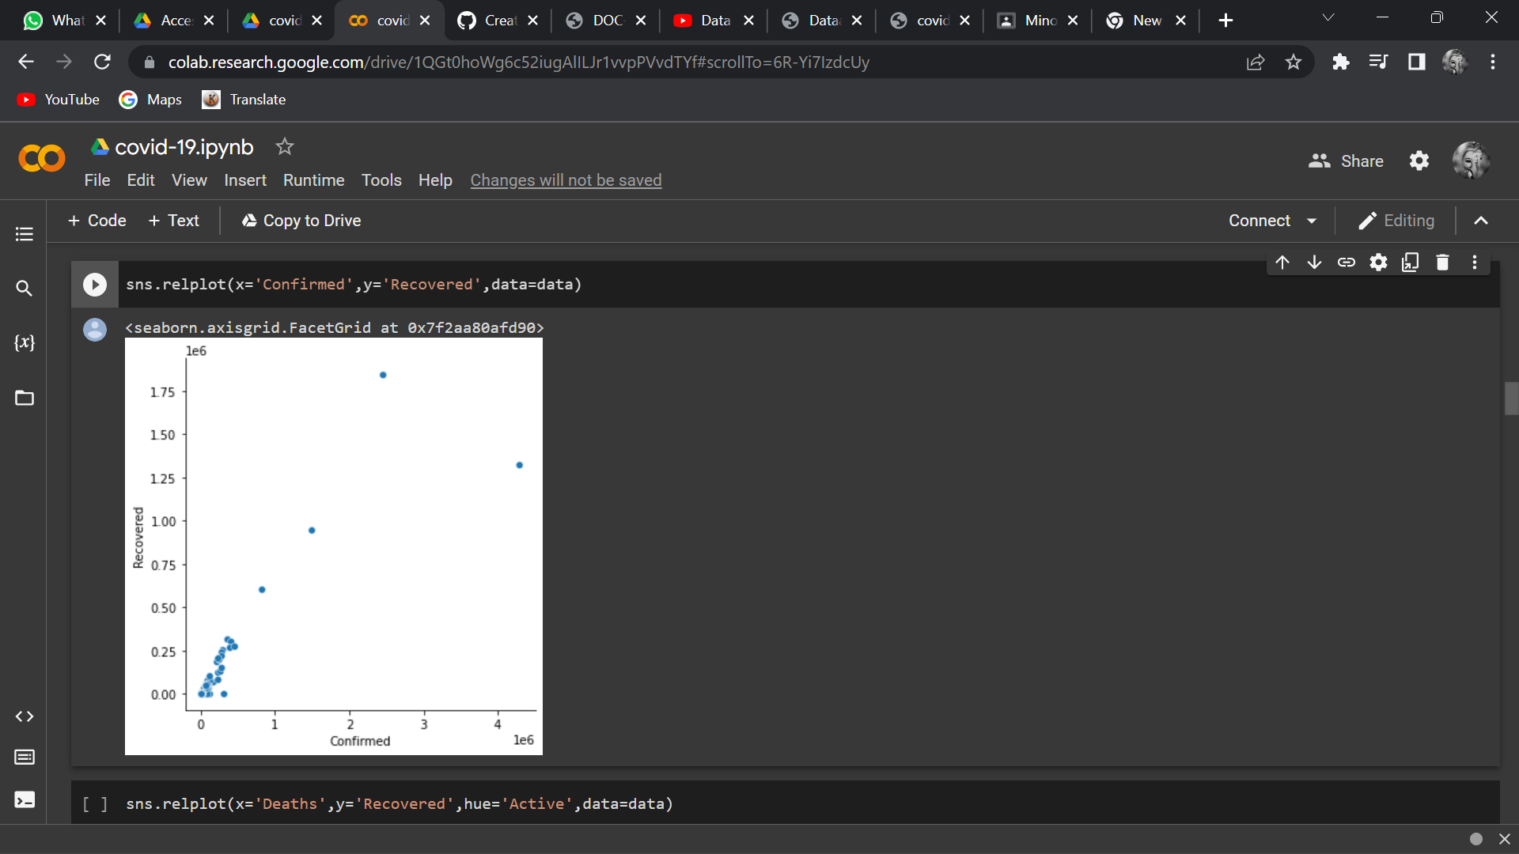
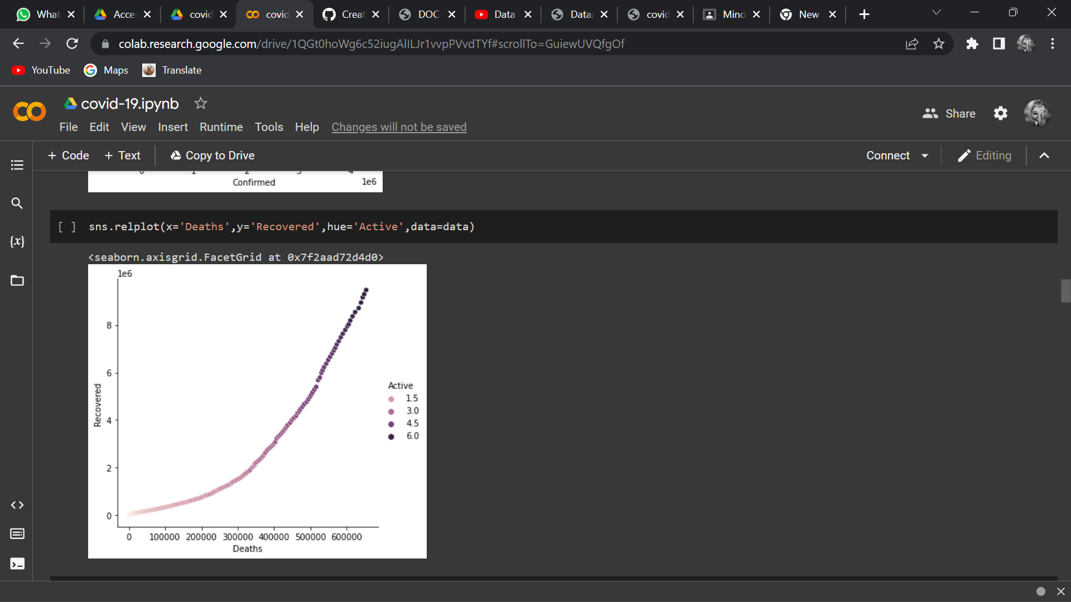
Relating the Variables with scatterplots

Slide 7
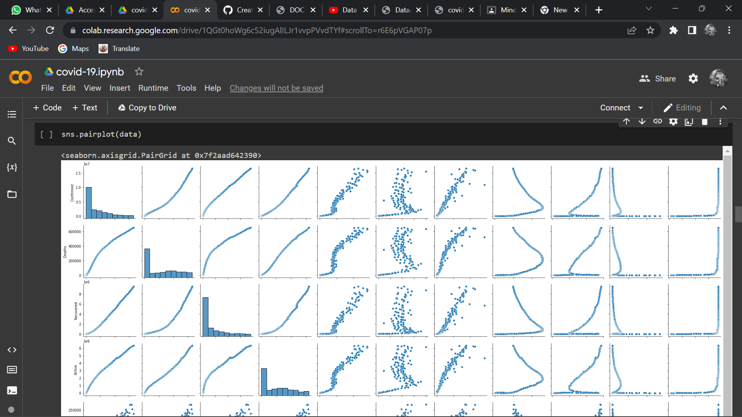
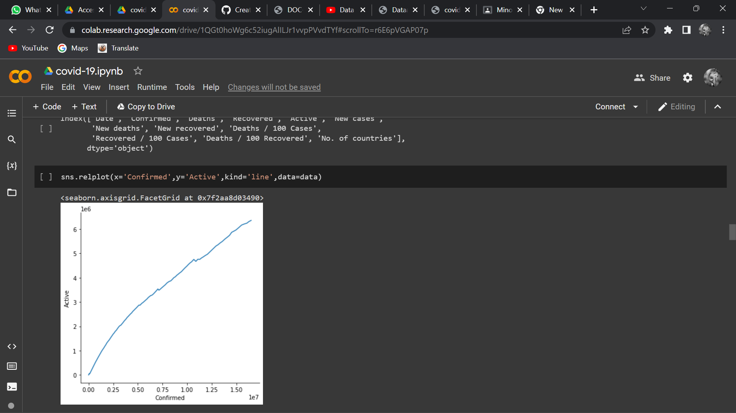

Slide 8
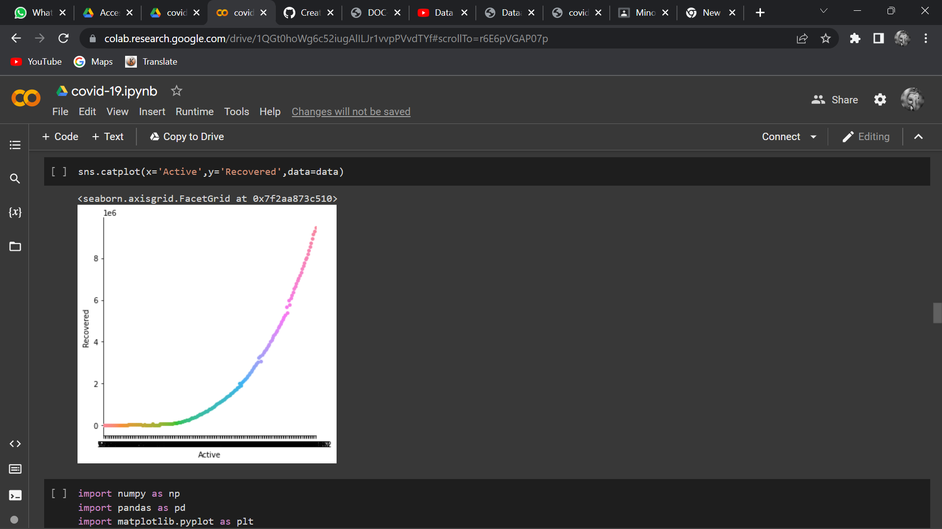
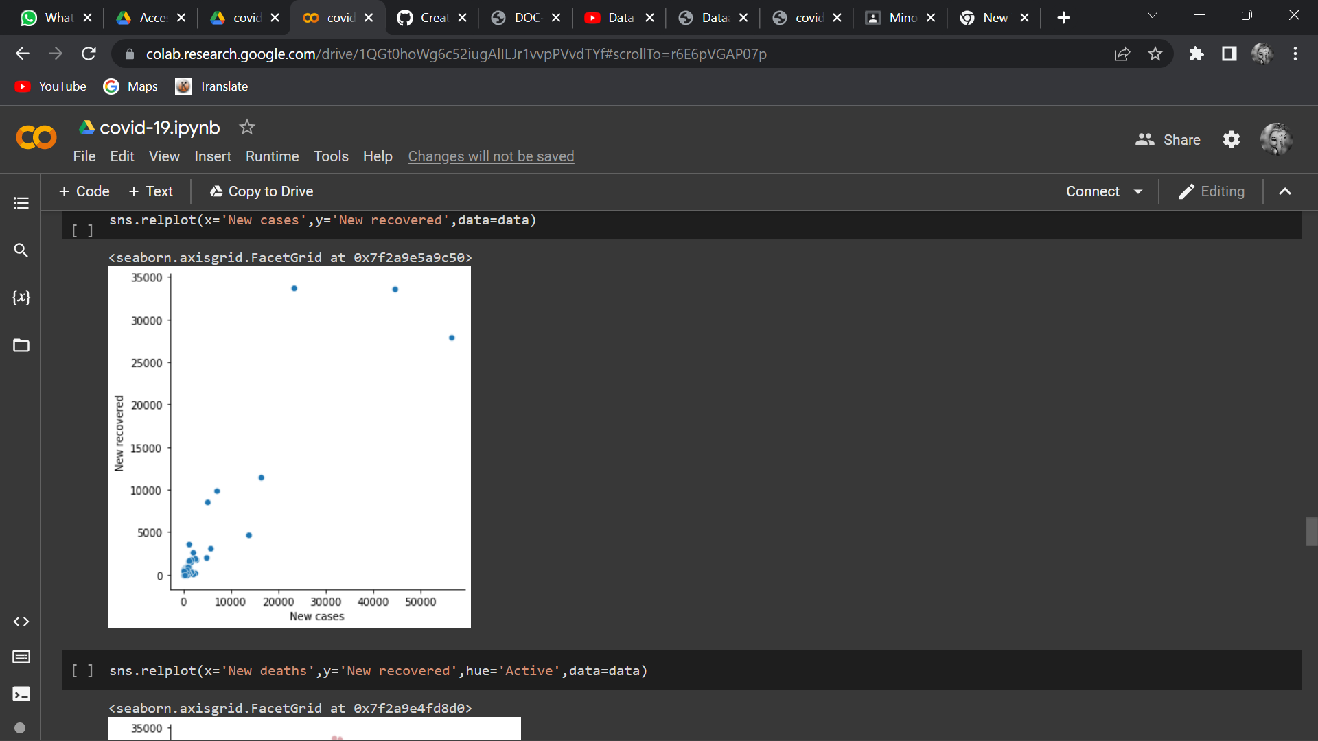

Slide 9
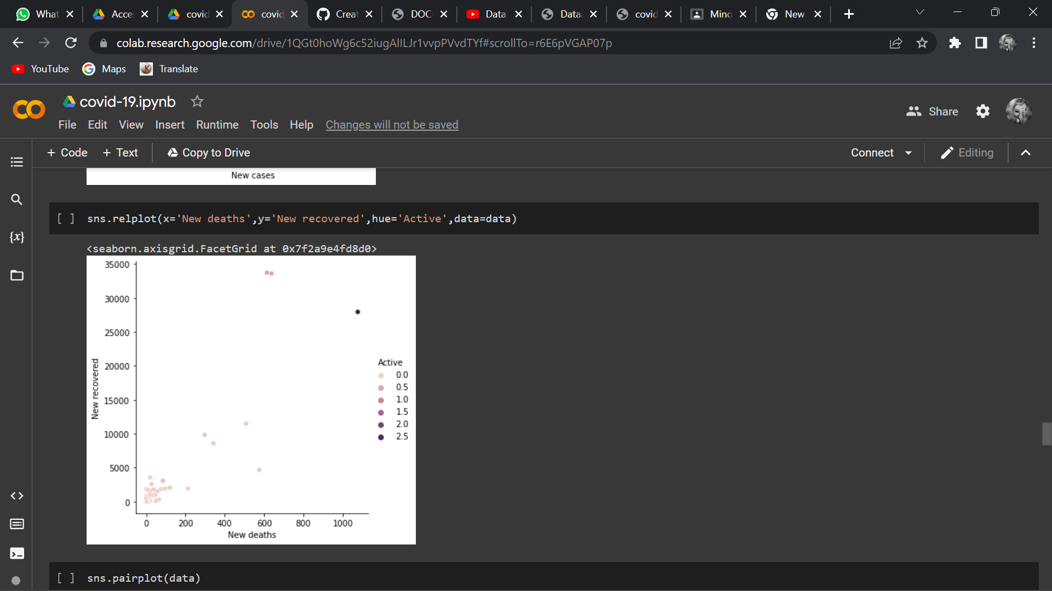
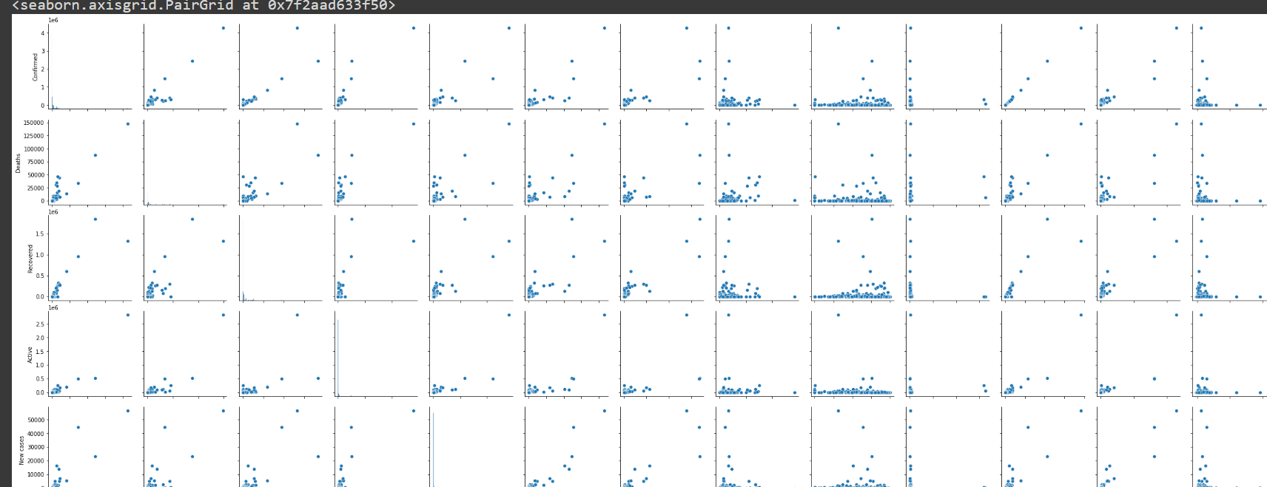

Slide 10

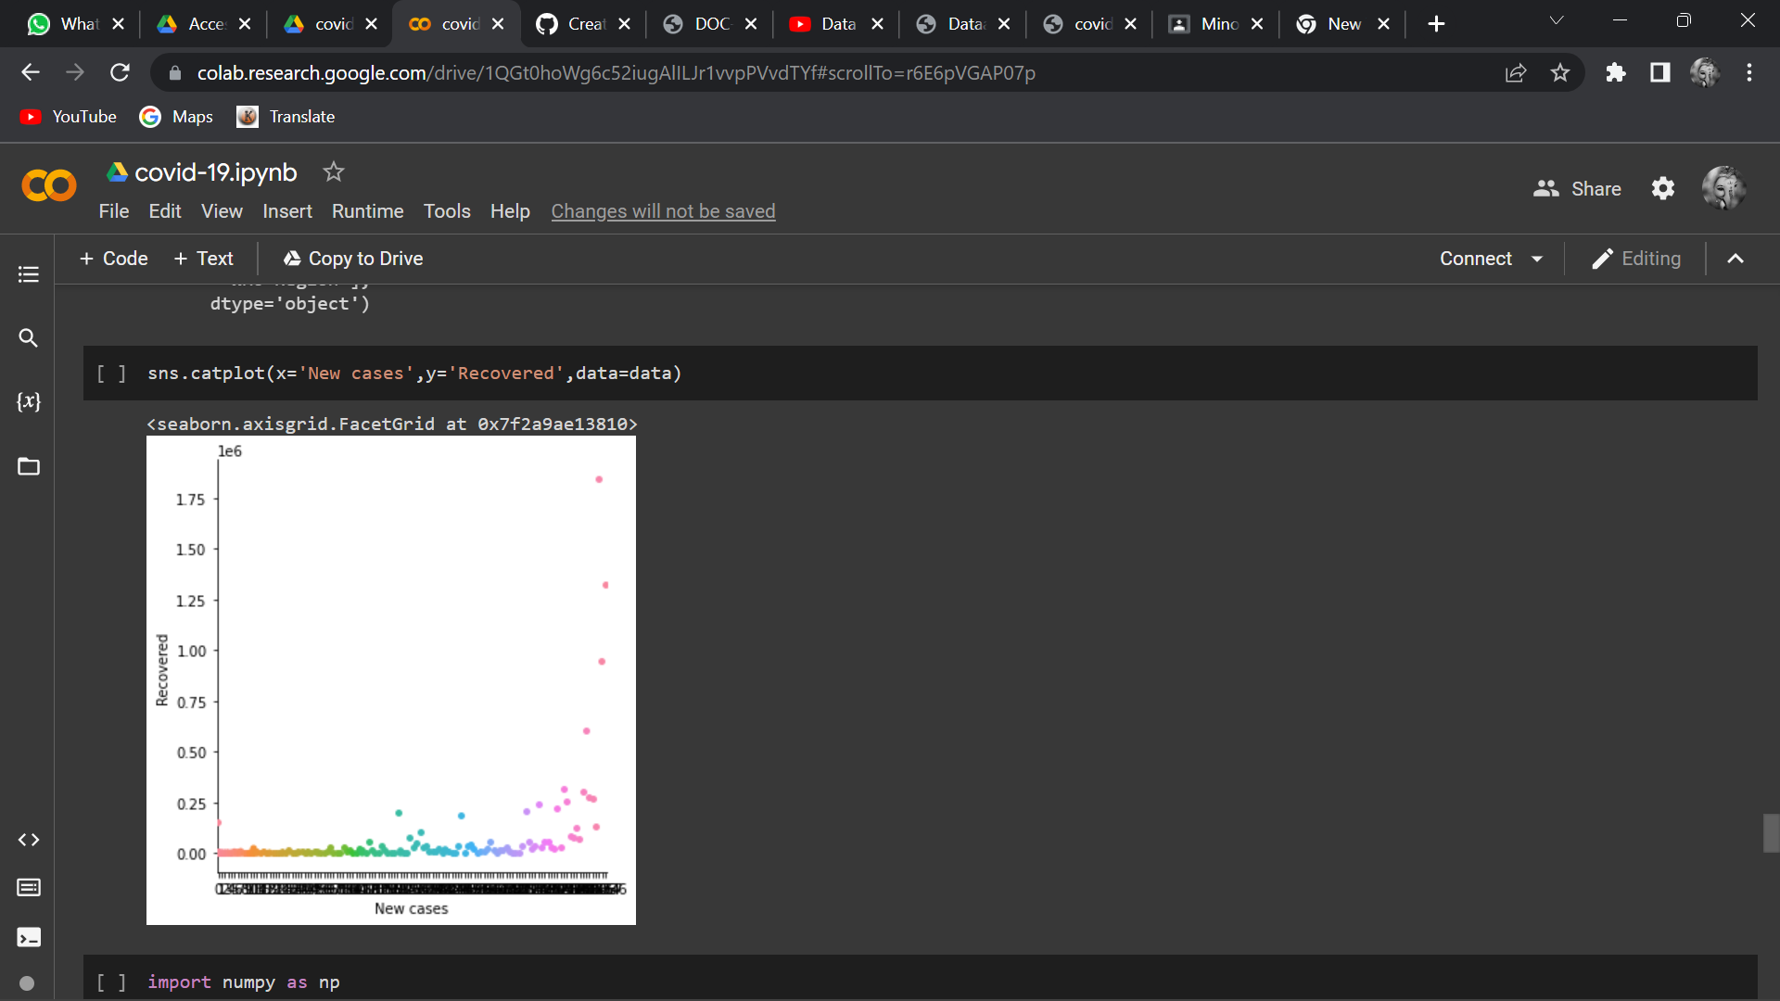

Slide 11
Conclusion:- COVID-19 outbreak which took place in China was recorded and visualized through different online platforms. Data analysis was done through several methods. Exploratory Data Analysis was used to analyze data and visualize the dataset provided by different sources regarding the emergence of the disease. Visual Exploratory Data Analysis (EDA) was used as a method to analyze the rate at which COVID-19 was spreading throughout the globe. In this method, the data was analyzed through a map that helps an individual to understand the epidemiological nature of COVID-19. Susceptible-Exposed-Infectious-Recovered (SEIR) model was used to predict the time and the rate taken for the spreading up of disease throughout the globe. In this modeling method, real-time data was collected and visualized to forecast the rate of increasing cases for COVID-19 and was also used to forecast the analysis of infection. The results from the SEIR model were further used to analyze data for sentiment analysis among the community regarding the outbreak of COVID-19. The COVID-19 outbreak spreads not only through the country’s policy but also through the social responsibility of each individual. The different online platform, updates the viewers with the situation of the disease including the number of confirmed cases, number of recoveries and number of deaths taking place throughout the world. Data analysis for COVID-19 is done to make aware humans against the infection caused by Corona.

